Slide 1

https://www.uni-goettingen.de/en/48115.html
Chapter 8 of <Breeding Method>
UNPLAB-BrMeth_Ch8[TheFour I]
1

Slide 2
Sequential Number: #26
UNPLAB-BrMeth_Ch-8[TheFour I]
Unless I explicitly state otherwise, images and cartoons are created using ChatGPT.
You may use this material free of charge under the terms of the CC BY license. This requires that you provide appropriate attribution to the author: W. Link, University of Goettingen, Germany.
In a few cases, individual images, photographs, or similar material may be subject to a more restrictive Creative Commons license. Where this applies, it is explicitly indicated, and you must comply with the stated license terms for those items.
Please check the license information carefully before reuse. Responsibility for complying with the applicable license terms rests entirely with you.
This symbol usually indicates that a page is rather important
2

Slide 3
You already know:
Population Genetics. Genotype frequency, Allele frequency, Hardy-Weinberg-Equilibrium, Inbreeding coefficient, Kinship, Selection, Drift, Migration, Mutation.
And GxE, h², Breeder’s Equation.
And you have already studied Recurrent Selection, that already gave you a good feeling for what Methodology is. Yet, Recurrent Selection is Pre-Breeding (Vorlaufzüchtung). We are now going to genuine Plant Breeding, Breeding in a narrow sense, which is Plant Cultivar Development.
Keywords of this chapter:
The four Categories in Plant Breeding. Pedigree Method in Line Breeding. Definition of an inbred line as derived partial bulk such as F3-derived partial bulk in F5 and the like. Homogeneous vs. Heterogeneous and Homozygous vs. Heterozygous (non-inbred) to differentiate types of cultivars across Methods and Categories.
Algebra as introduced in this chapter: none
3

Slide 4
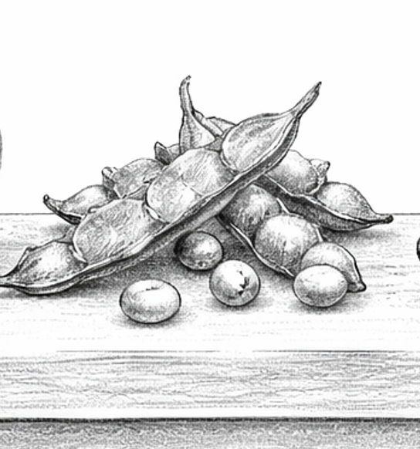
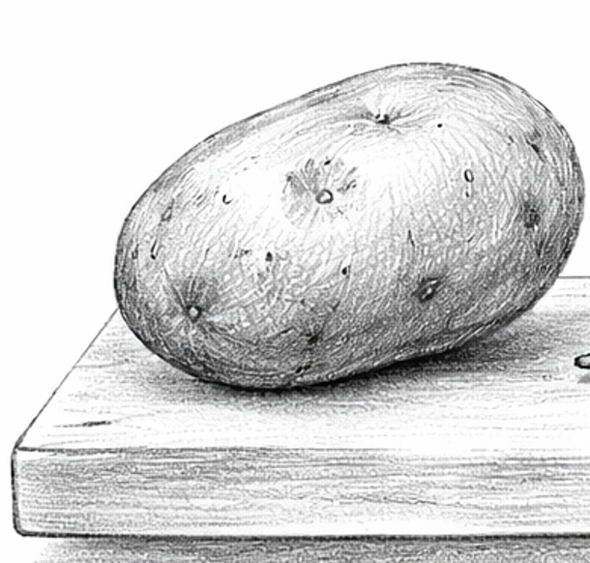
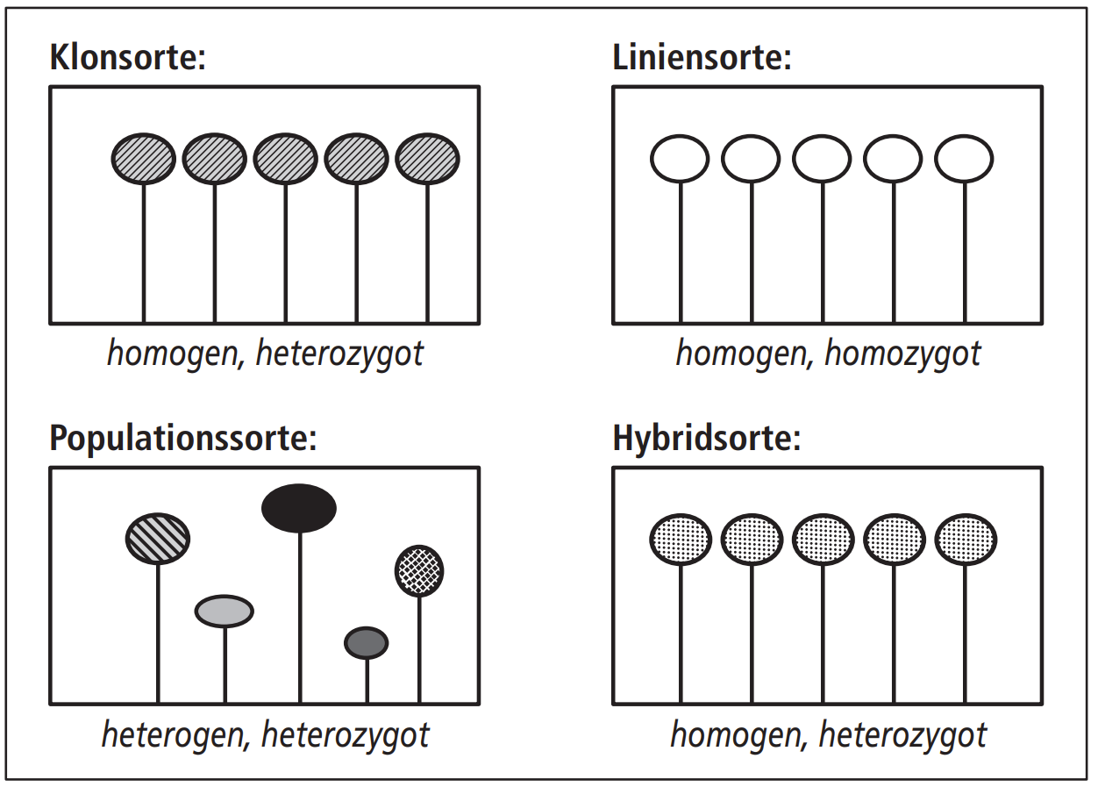
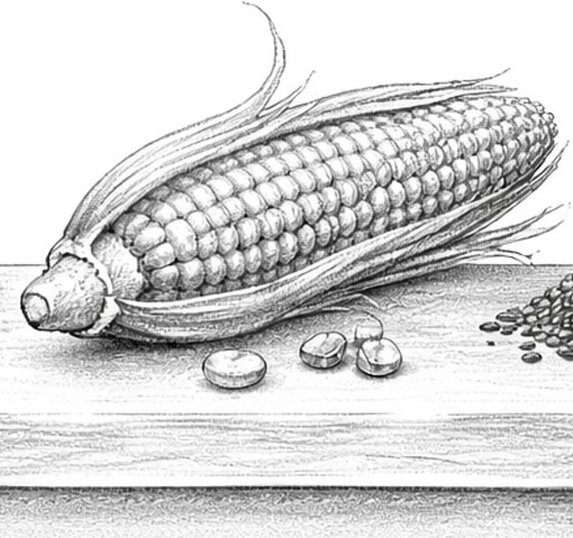
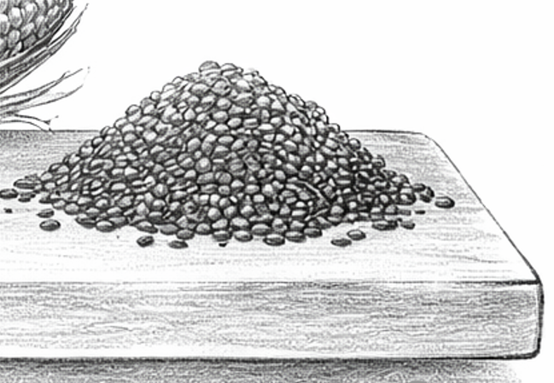

THE four Categories in Plant Breeding Methodology
Potato
Soy bean
www.dlg-verlag.de/shop/pflanzenzuchtung.htmlag.de
Clover
Maize
4

Slide 5

Let us get some orientation, so to say ‘longitude, latitude, altitude coordinates’.
Let us establish terms and definitions and a classification to not get lost ...
... so that we don't get lost, don’t get astray, in the jungle of terminology
(allo/auto-ploidy, mutation, segregation, combination and recombination, heterosis, GMO, sowing and planting, selection intensity, plant, genotype, candidate, cultivar, entry, scheme, technique, protocol, method, per se, genetic, genotypic, phenotypic, combining ability, varietal ability, and more ...
5

Slide 6
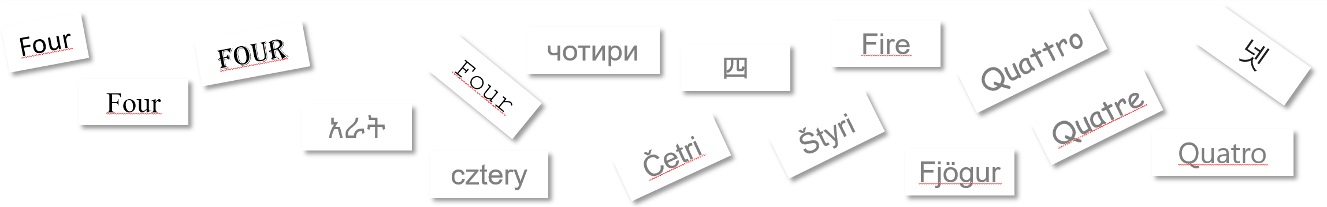
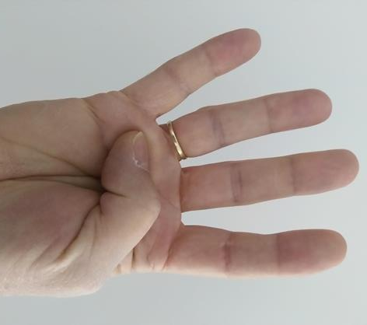
The basis of our ‚orientation‘ was laid down in Schnell’s
‘Synoptic study of the Methods and Categories of Plant Breeding’
(Journal Plant Breeding 89, 1-18). https://s.gwdg.de/2VhEHc
Vier
Authors of textbooks indeed classify Breeding Methods (methods of cultivar development) by means of various criteria. The natural reproductive mode is the criterion most widely used. SCHNELL (1982) put the system on a logical, plausible basis and included Hybrid Breeding as category (its ‘reproductive mode’ is the controlled, managed cross between cultivars’ parents). This system for teaching and thinking is used e.g. in Allard’s textbook, in the textbook of Sleper and Poehlman, and in the textbook of H.C. Becker.
Take the box as one of the Four Cate-gories. ‚Inside‘ such box are Methods.
There are four different reproductive systems (modes) realized when propagating cultivars. I mean, when producing the actual propagules (seed, tubers, bulbs, cuttings … which are sold to farmers as certified propagules for sowing and planting). Correspondingly, there are four categories of Plant Breeding.
6

Slide 7
The basis of our ‚orientation‘ was laid down in Schnell’s
‘Synoptic study of the Methods and Categories of Plant Breeding’
(Journal Plant Breeding 89, 1-18). https://s.gwdg.de/2VhEHc
Authors of textbooks indeed classify breeding methods (methods of cultivar development) by means of various criteria. The natural reproductive system is the criterion most widely used. SCHNELL (1982) put the system on a logical and plausible basis and included hybrid breeding as category (with its artificial reproductive mode being a controlled, managed cross). This system for teaching and thinking is used e.g. in Allard’s textbook, in the textbook of Sleper and Poehlman, and in the textbook of H.C. Becker.
Take the box as one of the Four Cate-gories. ‚Inside‘ are Methods.
There are four different reproductive systems (modes) realized when propagating cultivars. I mean, when producing the actual propagules (seed, tubers, bulbs, cuttings … which are sold to farmers as certified propagules for sowing and planting). Correspondingly, there are four categories of Plant Breeding.
Self-fertilization results in certified seed of line cvs., i.e. pure line cultivar, multi-line cv.
Panmicitic cross-fertilization results in certified seed of population cultivars, e.g. synthetic population cultivars.
Vegetative propagation results in certified tubers (or the like) of clone cultivars.
Controlled crossing between seed parent and pollen parent results certified seed of hybrid cultivars,
i.e. single-cross hybrids or three-way or double-cross hybrid.
Allard, R.W., 1999. Principles of Plant Breeding. 2nd edition, John Wiley & Sons
Sleper, D.A., and J.M. Peohlmann, 2006: Breeding Field Crops. 4th edition, Blackwell
Becker, H.C., 2019, Pflanzenzüchtung. 3rd edition, Ulmer
7

Slide 8
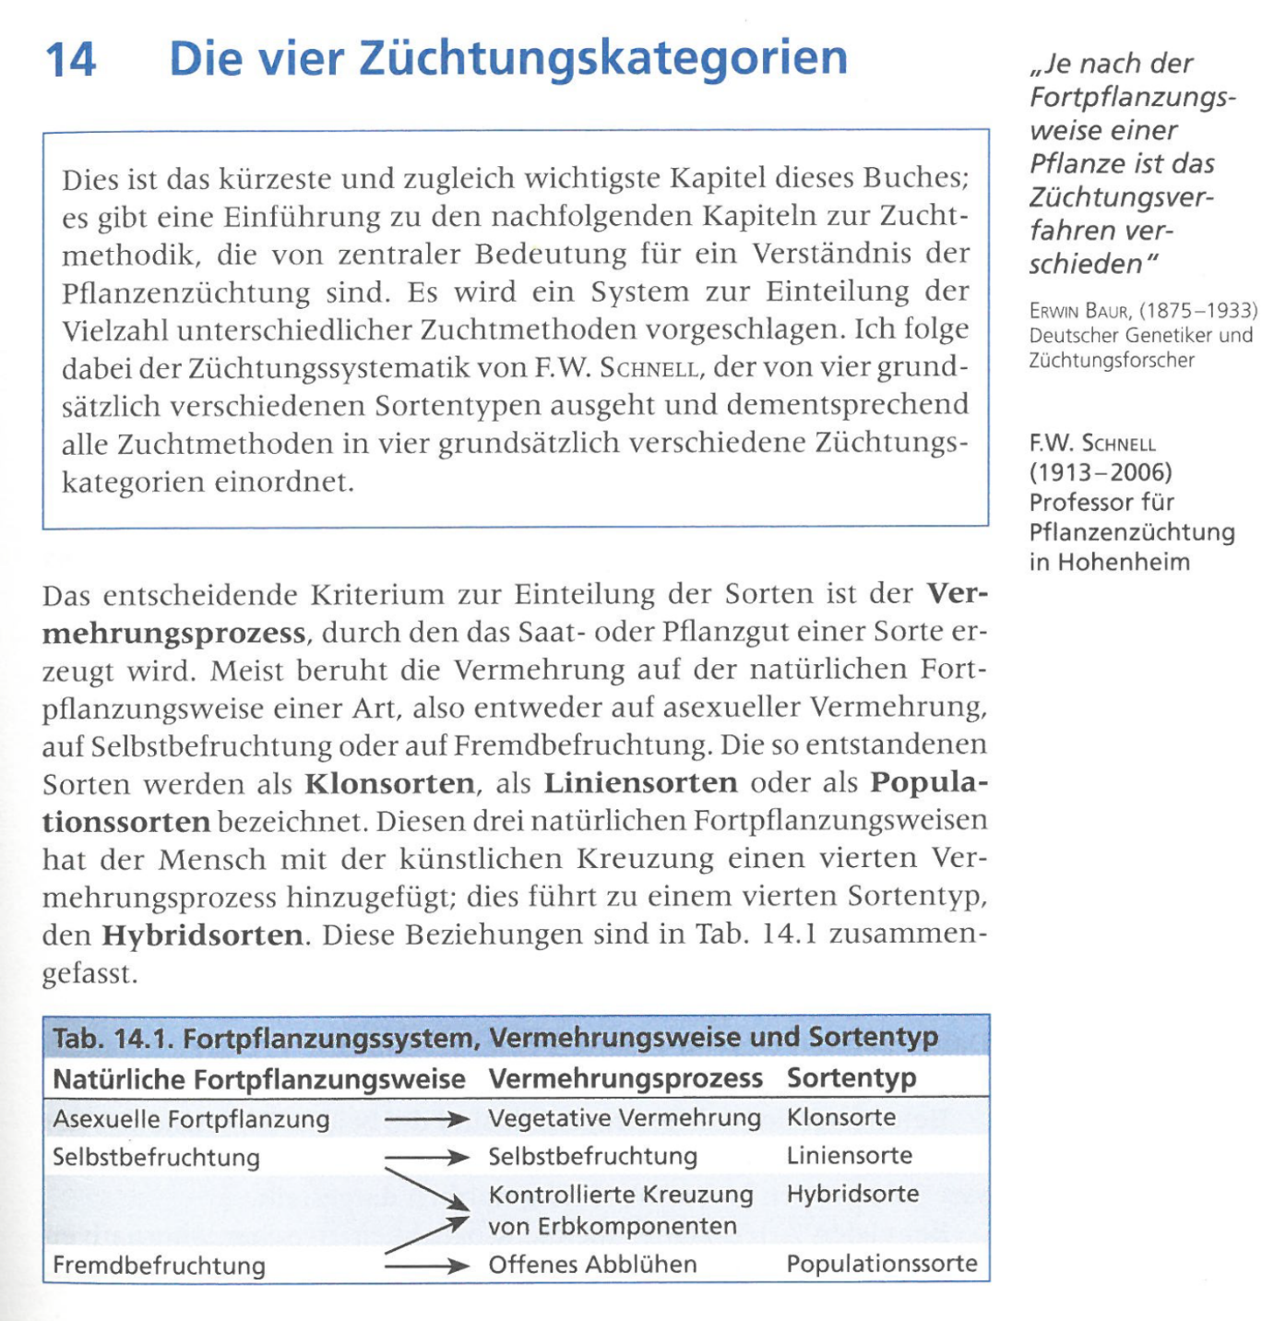

Lucky you are in case you can read and understand a German textbook ;-)
Heiko Becker, Pflanzenzüchtung
1993; 2011; 2019
© wl
8

Slide 9
The basis of our ‚orientation‘ was laid down in Schnell’s ‘Synoptic study of the Methods and Categories of plant breeding’, in the Journal Plant Breeding 89, 1–18.
9

Slide 10
The basis of our ‚orientation‘ was laid down in Schnell’s ‘Synoptic study of the Methods and Categories of Plant Breeding’, in the Journal Plant Breeding 89, 1–18.
For a self-fertilizer such as rice, a line cultivar or a hybrid cultivar can be bred. For an outcrossing crop such as rye, a popu-lation cultivar or a hybrid cultivar can be bred.
Crucial question: Is a tool available for mass-hybridi-sation (Bestäubungslen-kung; e.g. CMS-system, gametocide)? If not, then the natural reproductive mode applies and we see the line (rice) and the population (rye).
Certified seed
Certified propagules
10

Slide 11
The basis of our ‚orientation‘ was laid down in Schnell’s ‘Synoptic study of the Methods and Categories of Plant Breeding’, Plant Breeding 89, 1–18.
11
Although oftentimes yet wrongly people think that Heterosis is mainly a topic for Hybrid Breeding, Heterosis is of high relevance for all-but-one Breeding Categories. It does not exist in homozygous genotypes, so, not exist in line cvs. In (outcrossing) populations, the genetic diversity between their individuals is fatefully intertwined with the hetero-zygosity of their individuals, thus with Heterosis. Logically, population cultivars can’t ‘be’ by just one genotype. Hybrid breeding results from a managed cross. This prevents that a natural ‘own’ propagation re-creates the initial hybrid cultivar. Clones - well, take strawberries, potatoes, grape vine; they are not sown but planted, propagated by planting materials (‘propagules’ such tubers and cuttings and the like).

Slide 12
Homogeneity – Heterogeneity is a feature of a group (population, crop stand)
Heterozygosity – Homozygosity is a feature of the individual (genotype)
Landrace of a
self-fertilizer
Population cultivar
A group of plants could, for instance, be homogeneous for the degree of homozygosity of its individuals ;-)
A landrace* is a mixture of very many different genotypes, yet, more-or-less all of them are highly homozygous (remember the ‘famous’ barley landrace of Syria).
A population can be heterogeneous for the inbreeding status of its members. A population in Vicia faba (partially allogamous) for instance is a mixture of non-inbred and more-or-less inbred plants.
*ISBN 0-88936-884-8 Ch. 3; Int. Dev. Research Centre
*ISBN 1-56670-405-7 Lewis Publishers Chapter 3
Heterogeneity
Line
cultivar
Hybrid cv.
Clone cv.
Genetic structure of types of cultivars
(cf. Schnell 1982)
Heterozygosity
12

Slide 13
Homogeneity – Heterogeneity is a feature of a group (population, crop stand)
Heterozygosity – Homozygosity is a feature of the individual (genotype)
Landrace of a
self-fertilizer
Population cultivar
The stricter we select, the more (all else being same) we gain. Indeed, the 10 best, for instance, are as average less superior than the Best alone.
Landraces and populations, even if being highly produc-tive, consist of many genotypes. Hybrid cultivars are cre-ated from only two (or up to four) parents, so, from very few ones. Hybrid (‘SC’) and Clone cultivars and line cultivars are (contain) the – presumably – best genotype. The less many genotypes, the more potential to have the very best one(s) isolated. The less genotypes, the stricter, the better.
A line cultivar is – even – not only the best genotype, but the best gamete, the best haplotype (see later).
Ah! Now it's getting light, now it's getting bright! Finding one's bearings in the landscape, in the realm of possibilities in Plant Breeding.
Heterogeneity
Line
cultivar
Hybrid cv
Clone cv
Genetic structure of types of cultivars
(cf. Schnell 1982)
Heterozygosity
13

Slide 14
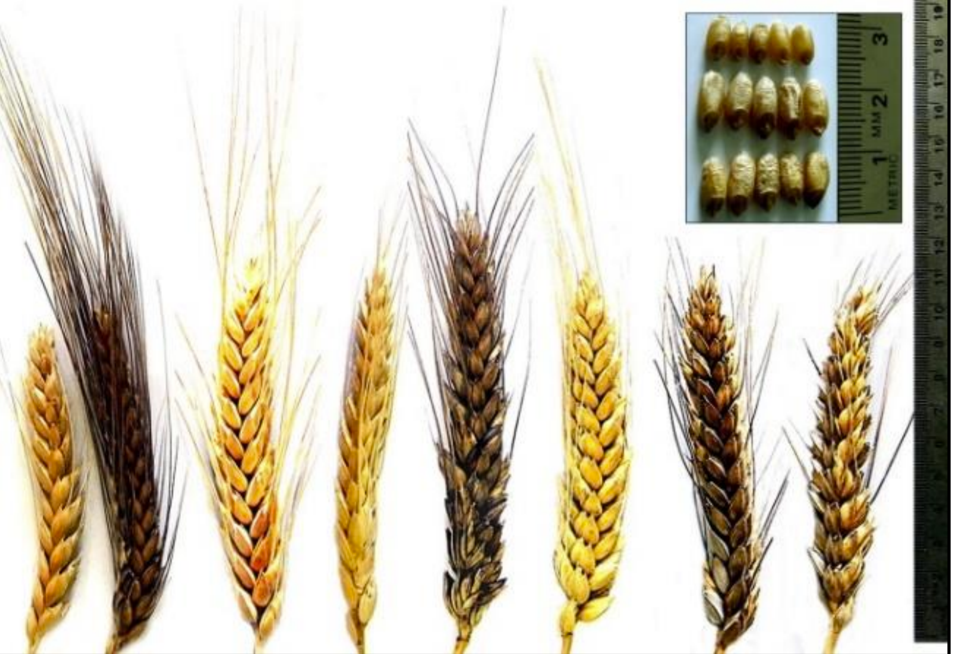
Line Breeding (appropriate for e.g. wheat, pea, teff, tobacco)
Line varieties (cultivars) are the usual type of cultivar in self-fertilizing crops. Most cereals (wheat, rice, barley, teff) and most grain legumes (pea, soy, common bean, chick pea, lentil, groundnut) are self-fertilizers. (Repeated) self-fertilization maintains or leads to homozygosity; homozygous genotypes are genetically stable when propagated by self-fertilization (‘true-to-type’, ‘samenfest’). To produce the heterozygous condition (from which genetic variation can be released for breeding), two different, homozygote parents are crossed. The resulting F1 is heterozygous for the genes that were different between the initial parents.
In the generations that follow F1 (i.e., F2, F3 etc.), this happens:
(1) segregations occurs and
(2) homozygosity is step-by-step restored.
Two basic schemes (Methods) were traditionally applied to breed cultivars in self-fertilizing crop species. In the so-called Bulk (Ramsch) method, the F1 is propagated for several (selfing) generations to stepwise increase homozygosity. Along these generations, natural selection may be allowed or avoided (cf. single seed descent, SSD). When applying the Pedigree (Stammbaum) method, artificial selection starts in generation F2. Selected F2-plants and F3-lines are not yet genetically stable, a selection during further generations is conducted. In later generations (from F4 or F5 or F6 on), these two methods look similar. The aim is to identify the ‘best’ genotype (best ‘inbred line’).
This later phase is even similar to Clone Breeding.
Example for marked segregation in ear type and shape. J. of Agr. Chem. Biot., Mansoura Univ., 12: 37 - 47, 2021
14

Slide 15
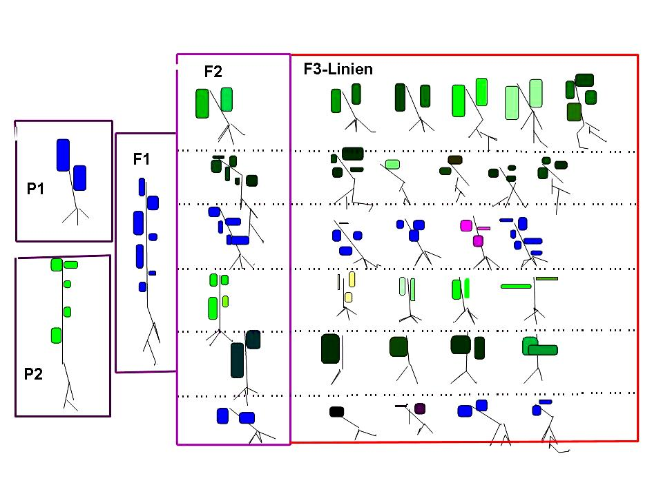
If this was Quantitative Genetics, then we would enjoy the very plausible, regular, beautiful pattern of variance allocation: Where does the genetic variance come from, where-to does it go, how much is already there, how much is there still to come?
See how two different homozygous genotypes (individuals) combine to their F1. See what is dominant (blue over green, short over long). See the segregation in F2. See surprises in F2 (blackish, either because of polygenic inheri-tance and/or because of epistasis; etc.).
See how the individual F2-plants segregate upon selfing. A blue F2 may even segregate a violet offspring.
See that the diversity between the F2-plants is larger than the diversity between the F3-plants within any F3-line. To some extent, the F3-line is bound to the general type of its ancestor-F2-individual - at least, alleles that were absent in an F2 individual can not segregate in its F3-line.
And so on.
F2
F3-lines
F1
P1
P2
© wl
15

Slide 16
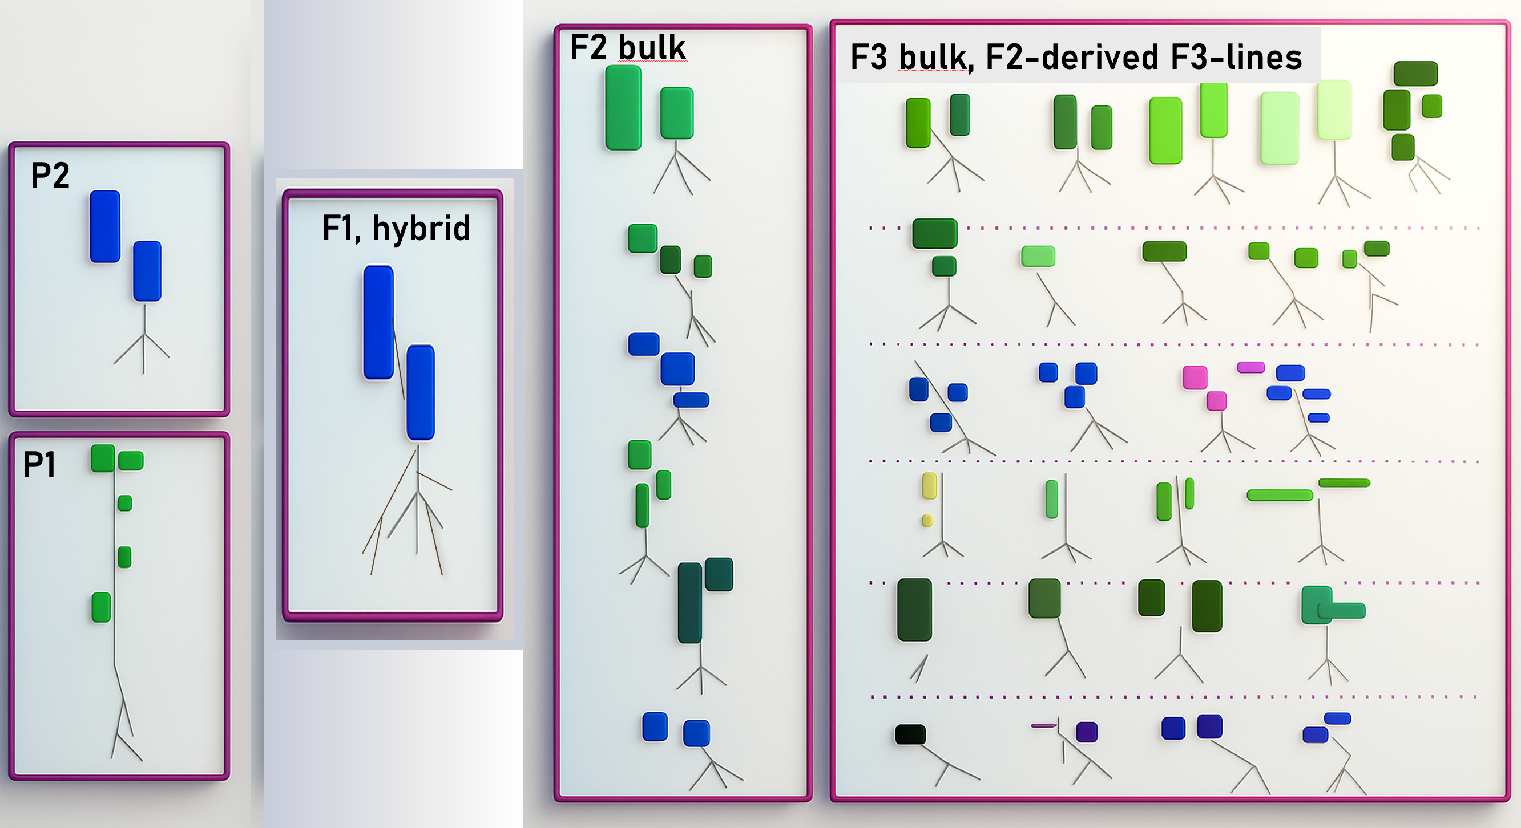
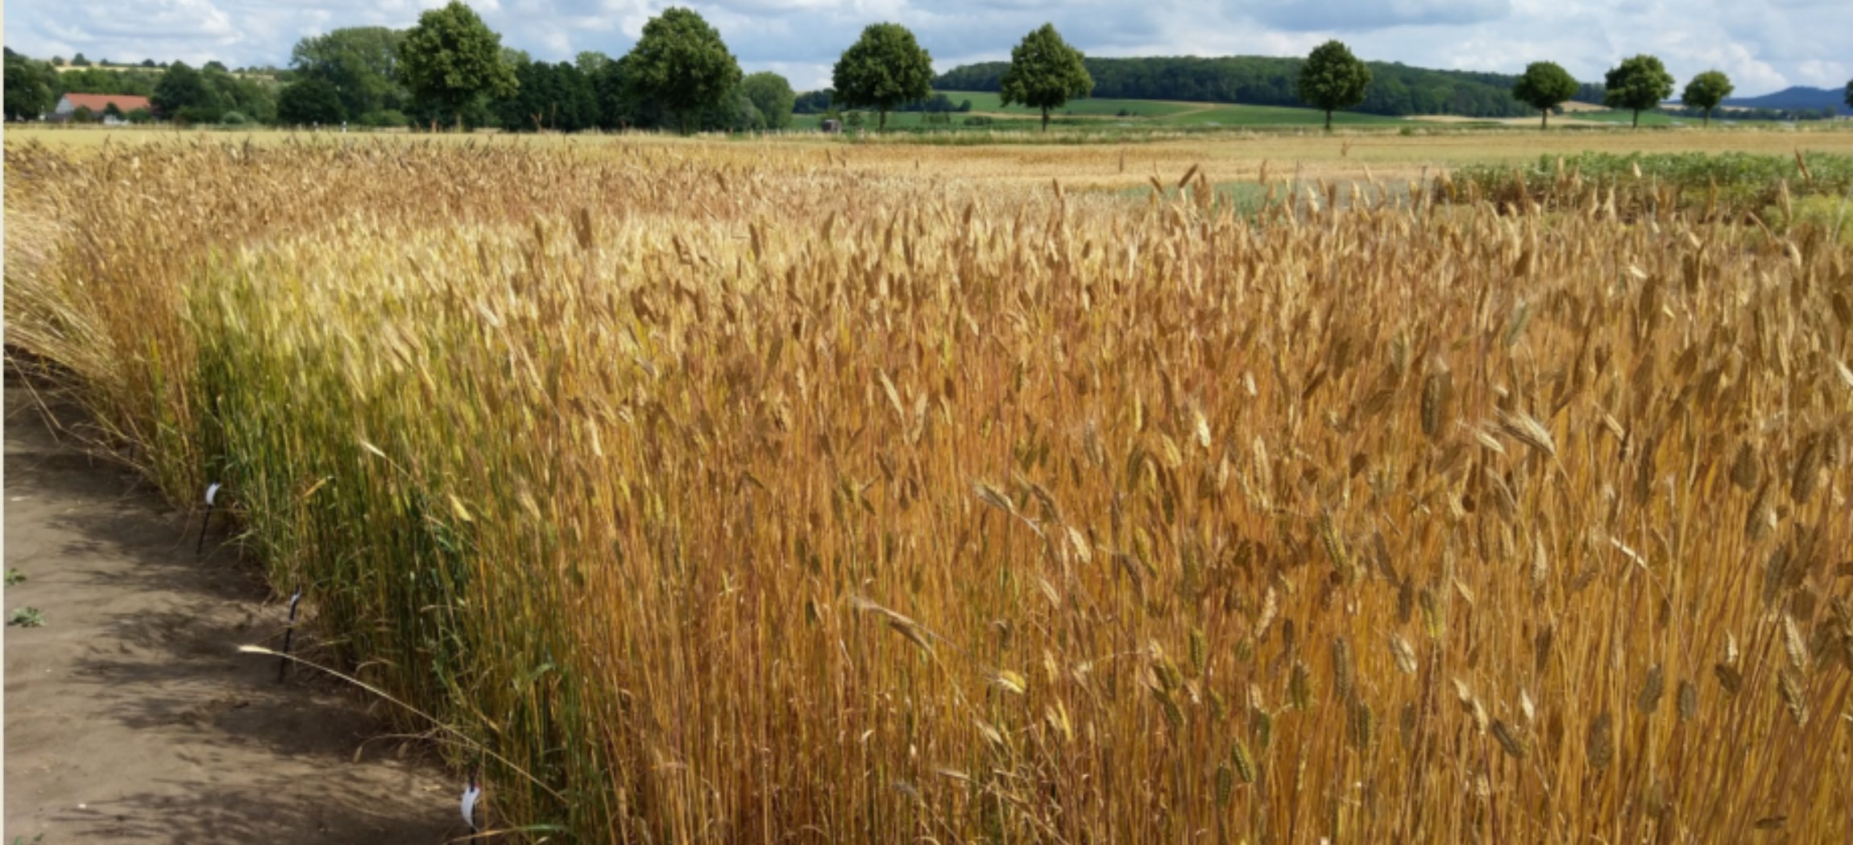
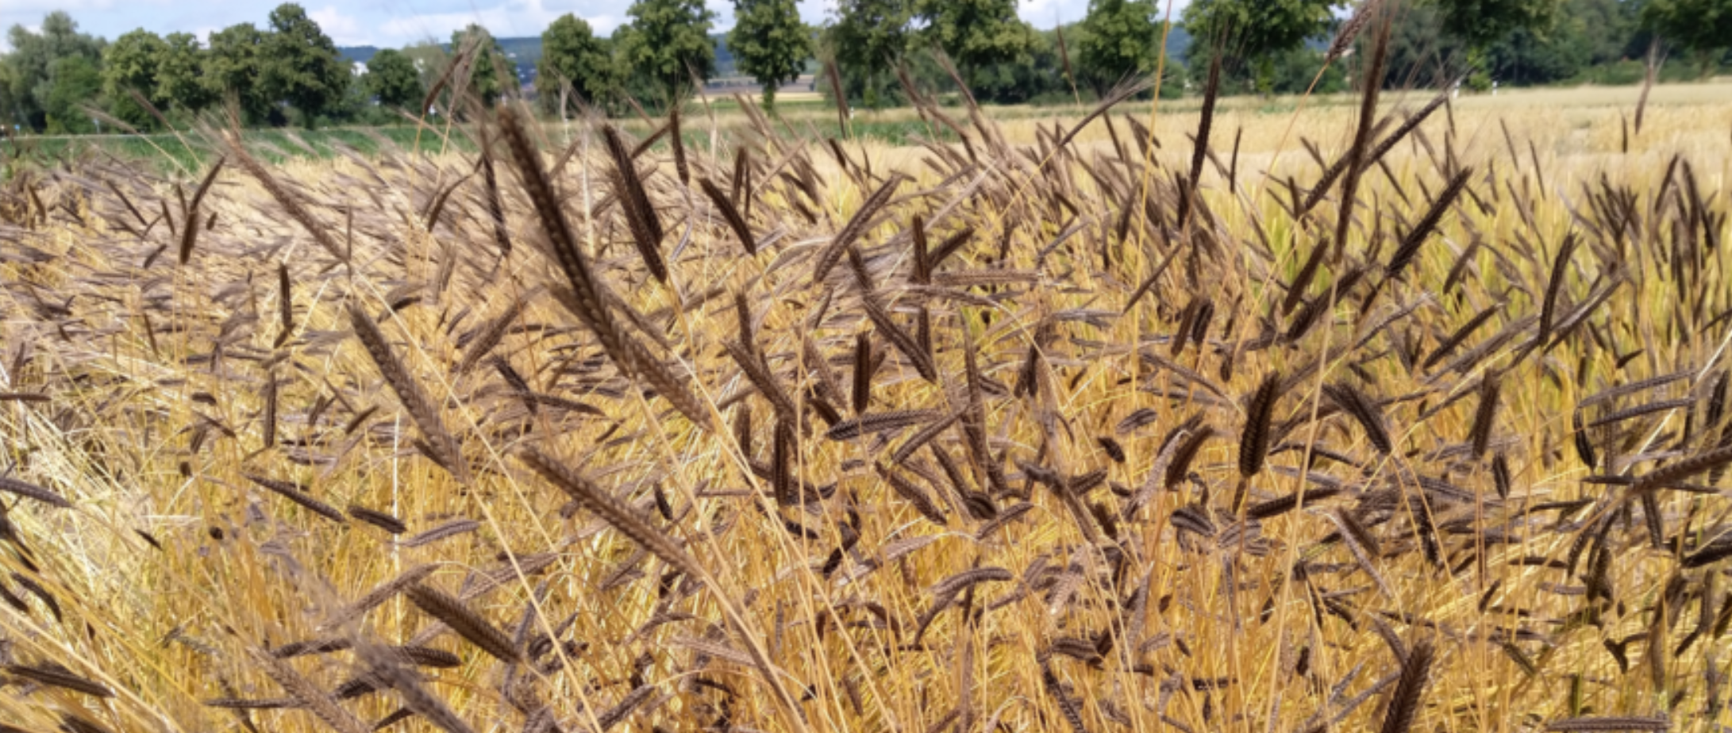
If this was Quantitative Genetics, then we would enjoy the very plausible, regular, beautiful pattern of variance allocation: Where does the genetic variance come from, where does it go, how much is already there, how much is there still to come?
Where is more genetic variation: Between the F2-plants or between their F3-offspring (aka F3-lines)?
If the trait is without dominance, then the quantity of genetic variance between the F2-plants is identical to that between the F2-derived F3-lines. And the genetic variance between all! F3-plants is – then – 1.5-fold of the variance between the F2-plants. Et cetera.
Yet. Zero dominance is a weird assumption, therefore the slightly more complex pattern of dominance segregation overlays the above-presented pattern. The combined outcome depends on the detailed genetic make-up of the trait(’s) segregation.
Quantitative Genetics has models for this;
(UNPLAB-QuGen_Ch-11[QG Lines I]).
. . . . . . . . . .
. . . . . . . . . .
. . . . . . . . . .
. . . . . . . . . .
© WLink
16

Slide 17
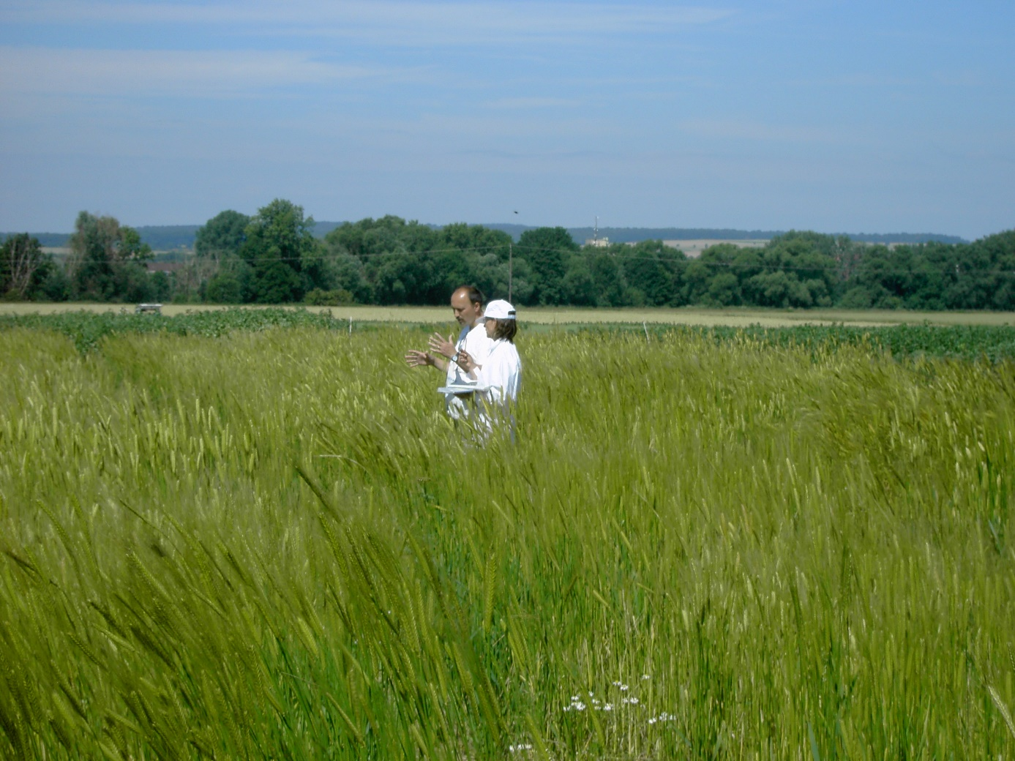
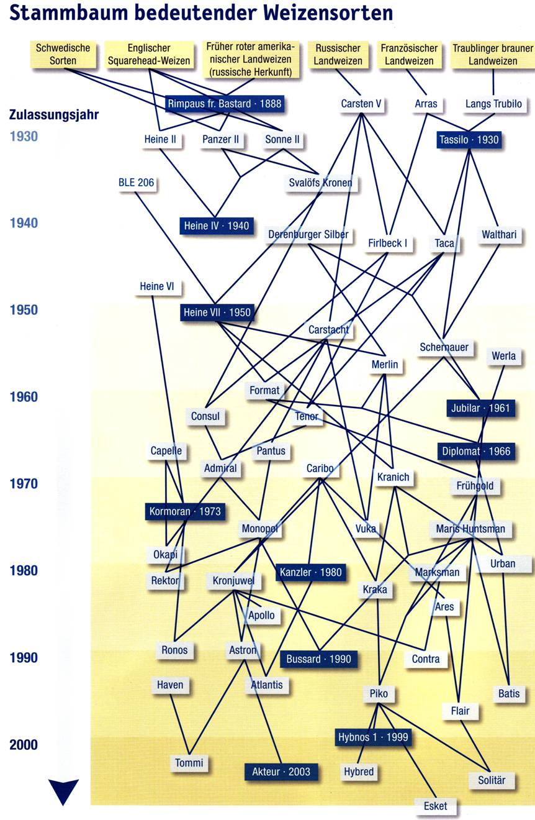
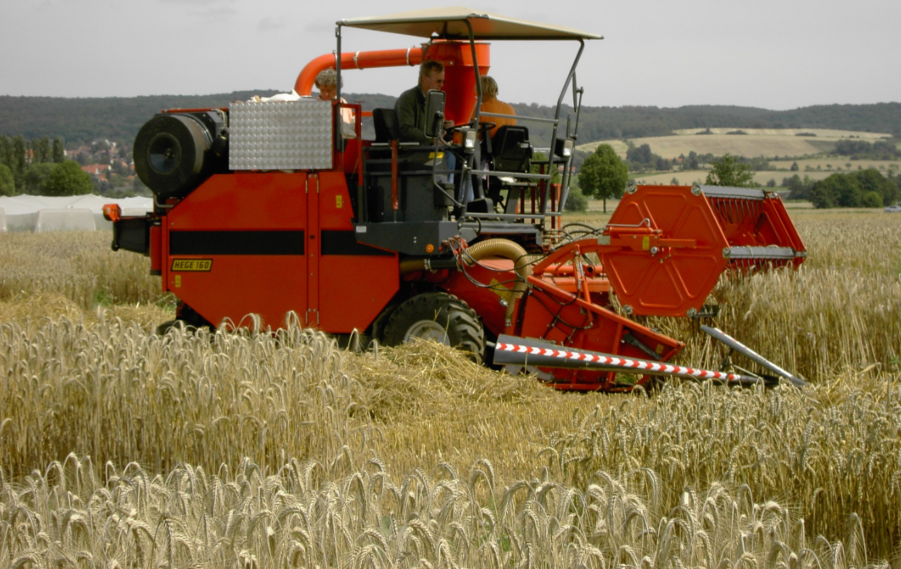
Pedigree of famous wheat cultivars (Curtesy www.z-saatgut.de)
Year of
release
There is nothing important to learn on this page. Just enjoy the pictures and think about a quote from Marie Antoinette: "There is nothing new except what has been forgotten."
Both © WL
www.z-saatgut.de
17

Slide 18
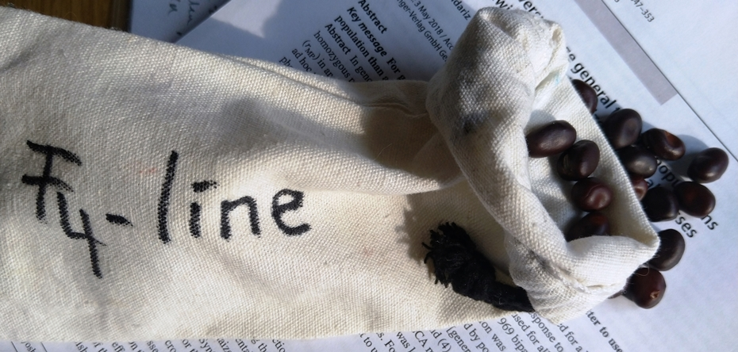
As you receive a seed bag from Line Breeding labelled F₄-line, you have received one of two pieces of information; watch out for the other, missing piece of information!
18
*unlinked QTL, of course, as so often here
The two pieces of information that you need:
What is the inbreeding generation of the seed? It is F4, hence on average
(1/2)³ = ⅛ = 12.5% of initial heterozygosity still present (½ in F2, ¼ in F3, ⅛ in F4).
What is the inbreeding generation of the least-remote single parental plant of that ‚entry‘. Maybe it is F2, then you received an F2-de-rived partial bulk in F4. Maybe F3, then …
How homozygous?
How much inbred?
How heterogeneous?
By the way. One (of several) reason to use field plots to test and select candidates for line cvs. (arable crops, row crops; e.g. F4-lines) and to not test the candidates with just one plant per each (one F4-individual per F4-line) is: In F4, plants are not yet homozygous. Let the F1 be heterozygous for 8 QTL (dominant-recessive gene action hence heterosis). In F4, plants are expectedly ‚still‘ heterozygous at one of the 8 QTLs. With this, the frequency of plants having e.g. ≥3 QTL heterozygous is 6.74%*. Therefore, best individuals in F4 will ‘cheat’ by realizing a more-than-average share of heterosis, yet they will loose this on their way to full homozygosity. Comparisons of F4-lines (each with, say, 200 plants) are not bothered by such transient bias. F4-lines’ results are the means of their member plants, their mean heterozygosity is very near to the expectation of 1/8. So: Among other strong reasons, this point of view is one further reason to select rather between plots of F4-lines than between F4 individuals.

Slide 19
Again, we need terms. See the illustration of terms in segregating generations under continuous selfing.
19
P
In F₂, no meaningful grouping of individual is possible (e.g. no grouping them in lines). All pairs of two individuals show the same pedi-gree relatedness and the same expected gene-tic similarity, although, of course, there is some random variation for actual genetic similarity; because number of independently distributed* pieces-of-chromosomes is limited (¿es claro?).
F
1
F
2
●
. . .
●
. . .
. . .
F
3
F
. . .
. . .
. . .
F PB
4
F L
2:4
3
In narrow sense, an inbred line such as F₅ traces back to a single plant in the generation before, i.e, F₄. An F3-line, hence, descends from an F2-individual. A ‘partial bulk in F₅’ came from an F3-line (F2:5) or F3-individual (F3:5), bulked until F5.
F
. . .
. . .
F PB
5
2:5
F PB
PB=partial bulk
3:5
F -line
5
*in meiosis
In short: F_{2:5}-partial bulk (in long: F2-derived partial bulk in F5; German: F₂-Teilramsch in Generation F₅).
If you got a paper bag with barley seed inside, labelled “F7”, then you know the inbreeding status of these seed. But you should in addition ask whether they were harvested from a single F6 plant or as bulk from a F6-line (with many plants); or ‘who’ actually was the least-remote single ancestral individual. The seed in your bag are genetically much more different from each other if your ‘line’ is an F_{2:7}-partial bulk than if it is an F_{6:7}-partial bulk. An F_{6:7}-partial bulk is already rather homogeneous, since a plant in F6 is already rather homozygous thus segregates little.

Slide 20
Category: Line Breeding. Method: Pedigree Method (Stammbaum-Methode)
This scheme is ultra-short. Dots indicate single plants which are assessed for selection. Rectan-gular shapes are field plots. Blue / black indicates superior entry (taken; selected). Do not take num-ber of dots & plots serious.
Breeders usually deal with > 48 F2 plants etc. ;-)
Cross parents
P₁
P₂
Self-fertilize F1 plant(s)
Select between F2 plants
Select between F2:3 lines and, as applicable, within them between
F3 plants
Select between F3:4 lines.
Seed harvested from all plants per selected line allow sowing of more and larger plots in F5.
Select between F3:5 lines
Example for marked segregation in ear type and shape. DOI: 10.21608/jacb.2021.61490.1011
Could be what you see in F2 in a ‘wide’ cross.
Experimental cultivar
20

Slide 21
21
Category: Line Breeding. Method: Pedigree Method (Stammbaum-Methode)
The same scheme; stretched. It shows a more normal duration of the phase of selection between lines & within-line-between-its-single-plants, starting in F3 and lasting until F5 (often even until F7); then single-plant selection is abandoned. Further-on selection is between lines only.
Cross parents
Self F1 plant(s)
Select F2 plants
Select F2:3 lines / plants
Select F3:4 lines / plants
Select F4:5 lines / plants
Select F5:6 lines
Select F5:7 lines
Example for marked segregation in ear type and shape. Hassan & El-Rawy 2021. J. of Agr. Chem. Biot., Mansoura Univ., 12: 37 – 47.
Experimental cultivar

Slide 22
22
In Line Breeding, cultivars must be homogeneous, thus highly homozygous.
‘DSU’ = distinct-stable-uniform. www.upov.int
Cross parents
A bit contrary to what I said at page 18, here selec-tion is including selection between single plants (such as between F3-lines and then, looking at best F3-lines, go and take best plant(s) within them) ... whereas later selection is only between lines.
Why? If your trait is not heterotic (e.g. lysin content) & error is small (not true for yield), then there is no heterotic bias in e.g. F3 or F4. If you build the lines on only one plant of the predecessor generation, then this creates lines that are increasingly homo-geneous. Would for instance the selection step ‚within‘ have been omitted in F4 (would best F4-lines be bulk-harvested), then in F5 we saw the segregation of what had been heterozygous in the F3-ancestor (F3-derived partial bulk in F5) – hence more heterogeneity in F5 than otherwise.
This would then most probably require a later step of ‘homogenization’, i.e. we then need to once resume the ‘individual-plant-based-selection’.
Self F1 plant(s)
Select between F2 plants
Select F3:2 lines / plants
Select F4:3 lines / plants
Select F5:4 lines / plants
Select between F6:5 lines
Select between F7:5 lines
Experimental cultivar

Slide 23
From here you may go to UNPLAB-BrMeth_Ch-9[TheFour II]
23
23

